Slide 1



FLAMES AND LUCKY NUMBER CALCULATOR
NAME:NAGAROSHAN N S
ROLL NO:22AIB06
GUIDE NAME
Tr. Sikkandhar Batcha J, M.E.

Slide 2


This abstract presents a Flames and Lucky Number Calculator, an online tool that provides quick calculations for two popular games used to determine compatibility and luck. The Flames Calculator determines the relationship compatibility between two individuals based on their names, while the Lucky Number Calculator generates a lucky number for a given person. These calculators aim to provide amusement and entertainment, allowing users to gain insights into their relationships and lucky numbers. The tool utilizes simple algorithms and user-friendly interfaces, making it accessible to a wide range of users. The Flames and Lucky Number Calculator serves as a lighthearted resource for individuals seeking fun and light entertainment.
ABSTRACT

Slide 3





FRONT END TECHNOLOGY
HTML
CSS

Slide 4



BACK END TECHNOLOGY
FLASK
MYSQL
PYTHON

Slide 5
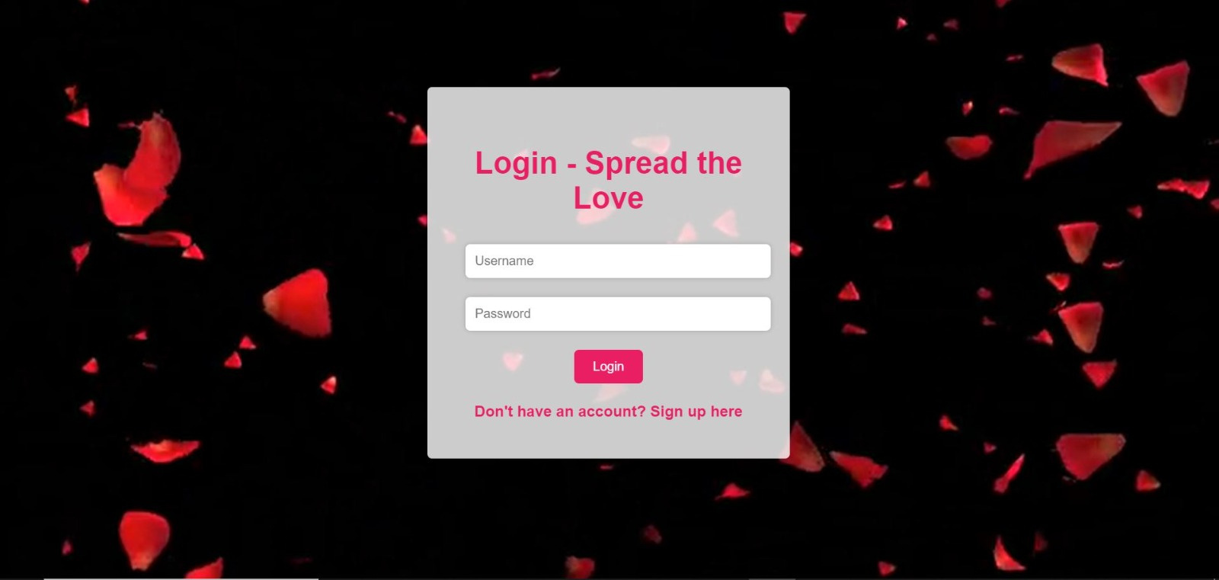
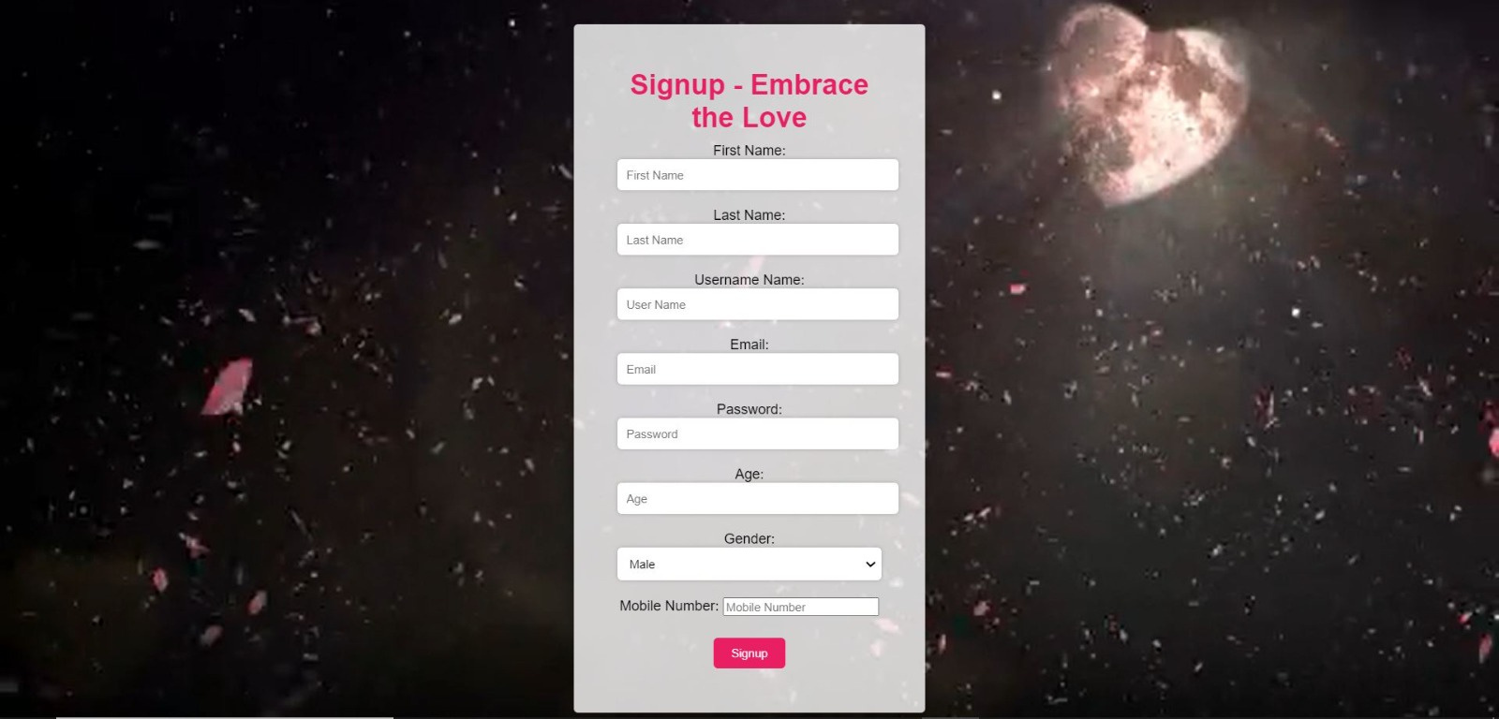
SIGNUP
LOGIN

Slide 6


OUTPUT-1

Slide 7
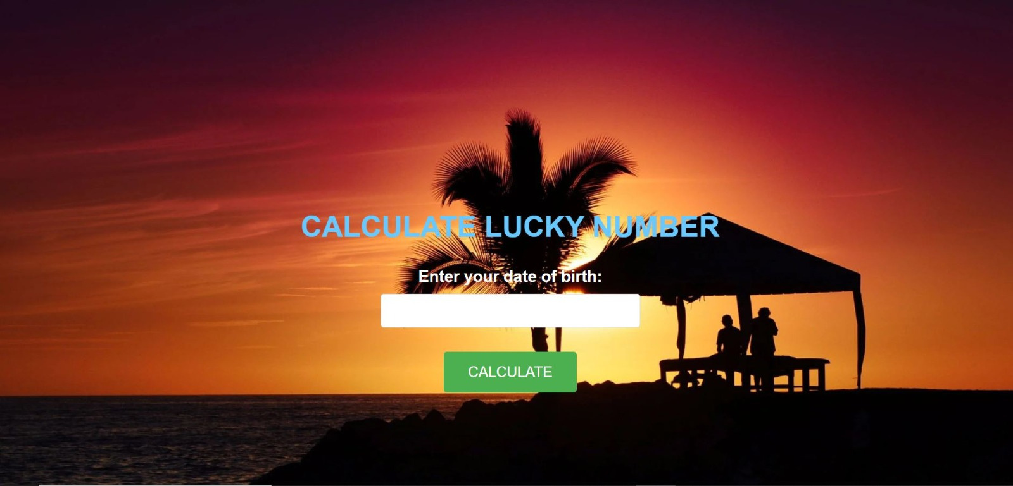
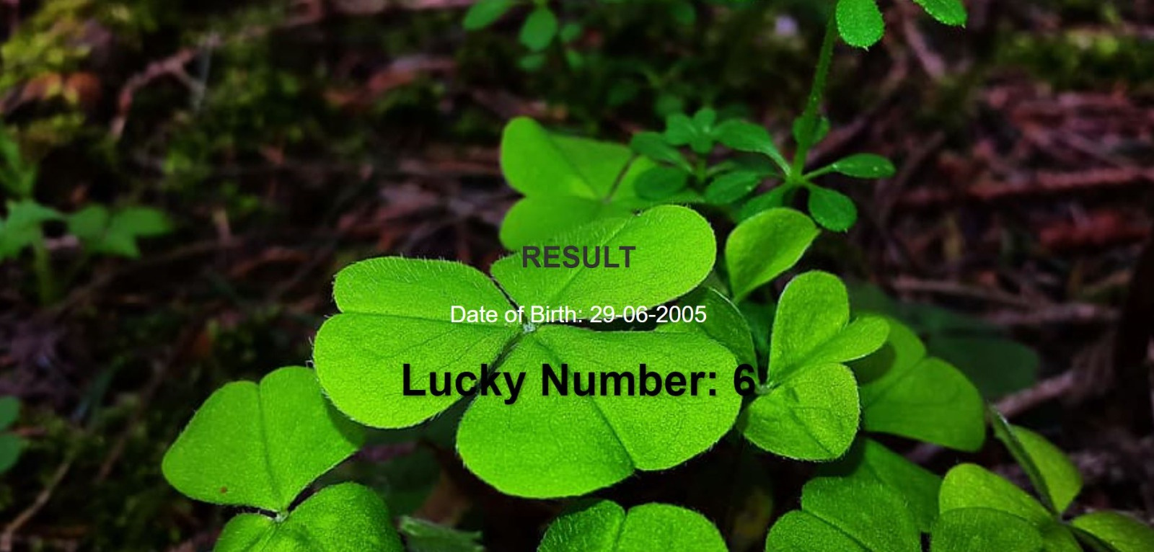
OUTPUT - 2

Slide 8

Thank
you

